Slide 1
SIADS 591-592 Milestone 1 Project
Greenhouse Gas Emissions from Upstream and Midstream US Oil and Gas Operations
By Rafee Shaik and Greg Myers
April-May 2020

Slide 2
Project Overview
The purpose of this project is to examine established Greenhouse Gas (GHG) Emissions data and determine if there is a correlation between accelerated hydrocarbon (Crude oil and Natural gas) production through horizontal drilling and hydraulic fracturing in the most recent decade and GHG emissions rates.
If a correlation is found, additional analysis may be able to reveal the causal source. The project will focus on three GHGs, Carbon-Dioxide (CO2), Methane (CH4), and Nitrous-Oxide (N2O).

Slide 3
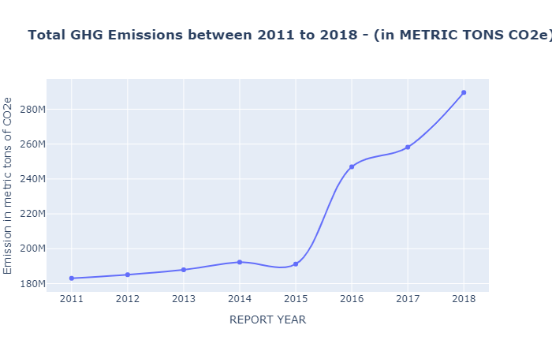
Fig-1: Trend line of total GHG emissions from US Oil and Gas Companies between 2011 and 2018.
Fig-1 shows the upwards trend in GHG Emissions from Oil & Gas upstream and midstream systems

Slide 4
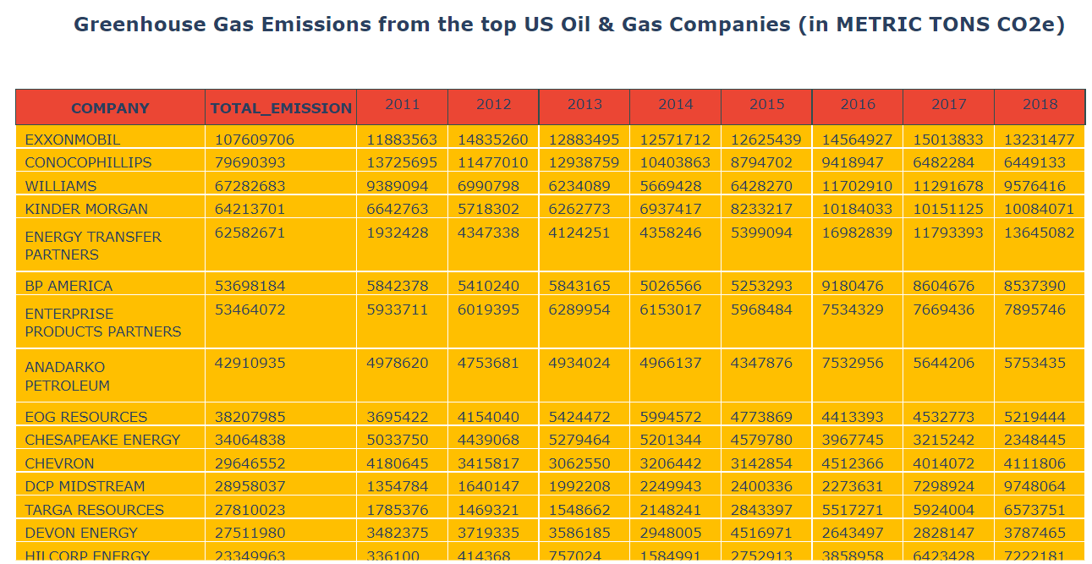
A summary table showing GHG Emissions from the top US Oil and Gas Producers between 2011 and 2018

Slide 5
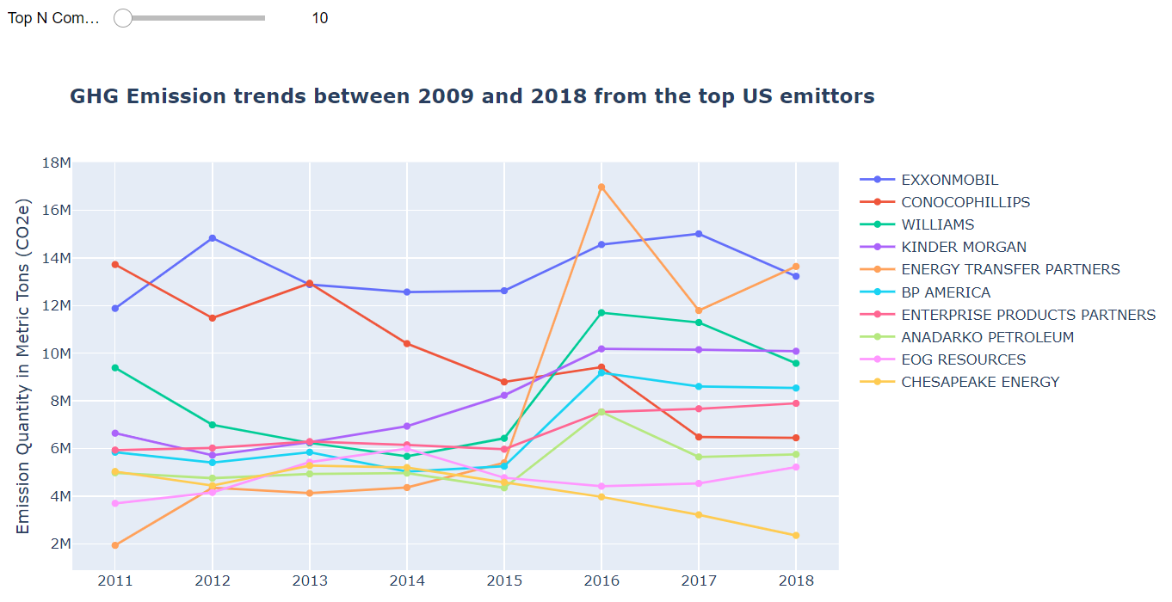
An Interactive chart - Emission trends between 2009 and 2018 from the top US emitters
Observations from the visualization:
From the chart you can visualize how GHG emissions from top US emitters changed in last 8 years.
ConocoPhillips emissions are trending down between 2011 and 2018 while Energy Transfer Partners emissions trending up.

Slide 6
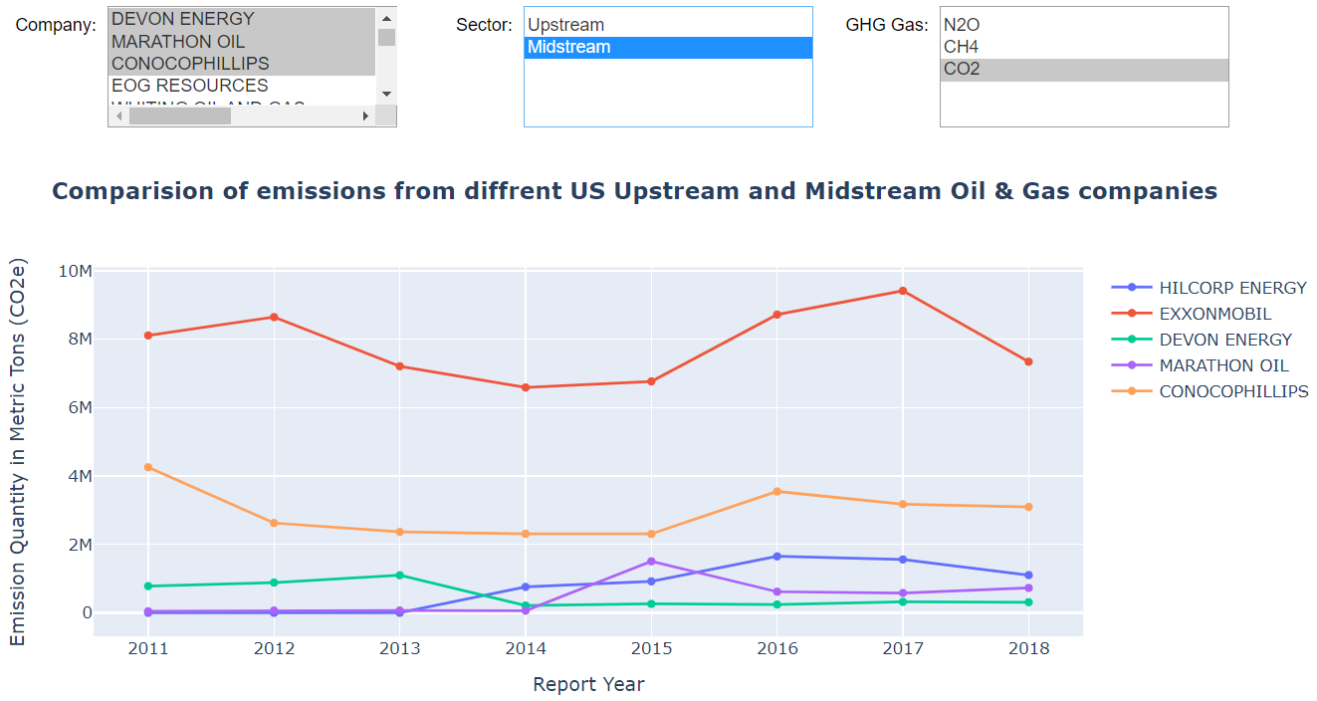
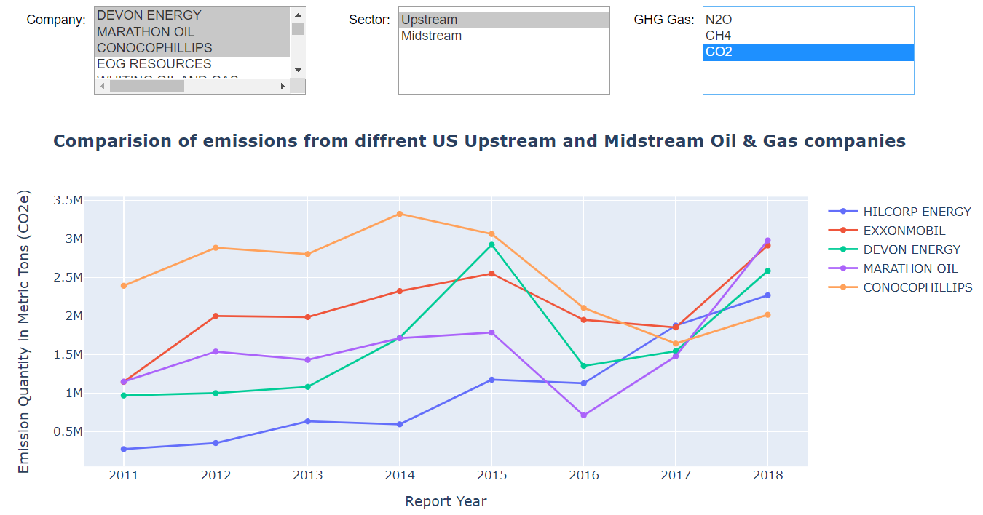
Study of emission from various companies’ individual sectors and GHG gas type Use below interactive chart to drilldown into individual sectors and GHG gas types
Emissions from Midstream
Emissions from Upsteam
Observations:
We used this interactive chart to study the Upstream and Midstream CO2 emissions from the top 5 emitters.
The chart show Midstream emissions are higher when compared to Upstream operations of the same companies
Upstream emissions were down between 2015 and 2017 due to the Crude oil market downturn but started picking up since 2016.
Oil market downturn doesn’t seem to impact emissions from midstream operations

Slide 7
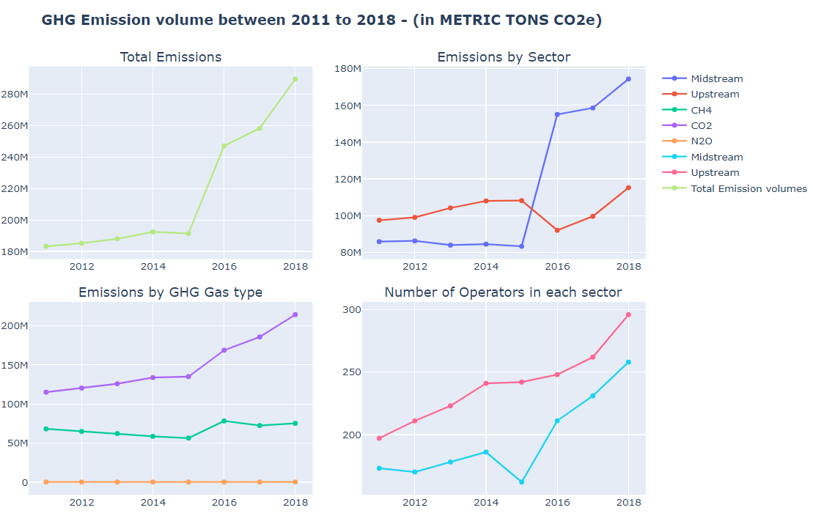
Emissions by Sector, GHG Gas type, and Number of companies operating in each sector
Observations:
Overall, emissions are on the rise from Oil & Gas Operations
There seems to be a jump in emissions from midstream operations
N2O emissions are negligible from Oil&Gas industry
There seems to be an impact on midstream operators in 2015 energy sector downturn, but there is no impact on number of upstream operators

Slide 8
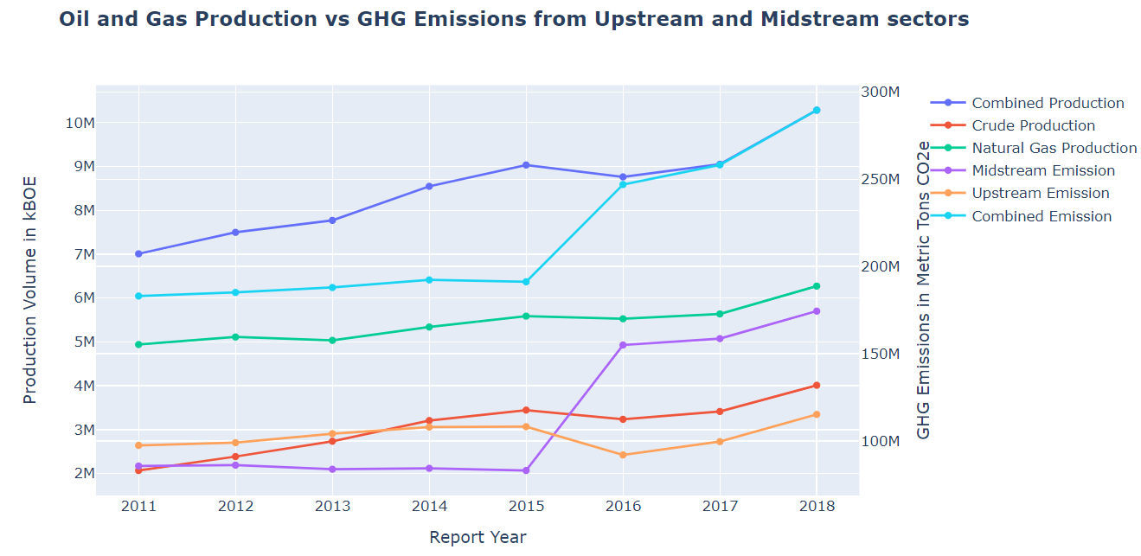
Comparison of Emissions from Upstream and Midstream Sectors VS Crude Oil and Natural Gas Production

Slide 9
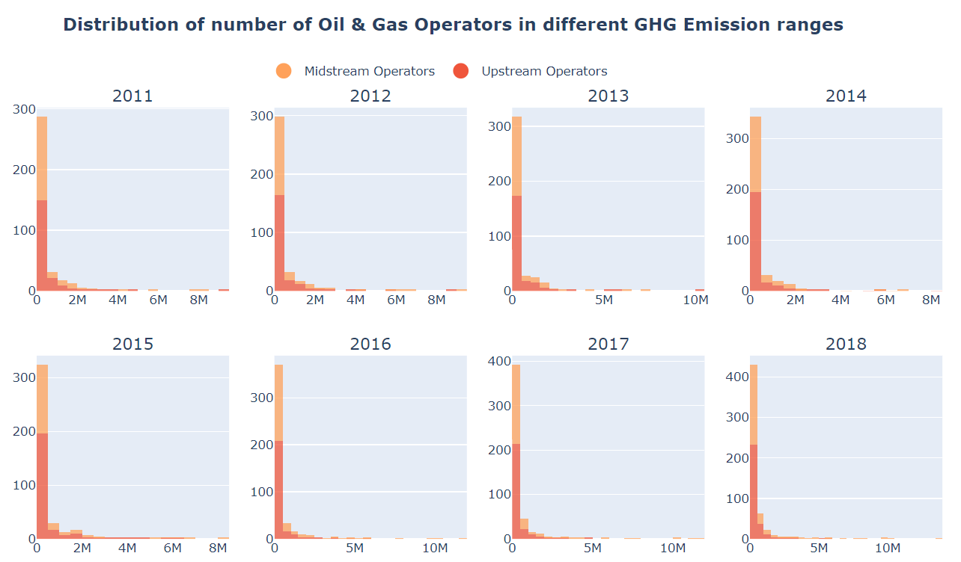
A histogram to identify the common emission quantity range from US Oil & Gas companies
Observations:
Most of the Oil and Gas companies emit less then 500K metric tons of GHG gases.
There are very few companies producing over 5 million tons of GHG gases

Slide 10
A linear regression analysis between emission quantity and production volumes
We will use linear regression model to estimate 2019 emissions from 2019 Oil and Gas production volumes
Since we have only 8 datapoints to run the linear regression we are going to use all datapoints to train the model.
Correlation between hydrocarbon production and emission from different sectors:
Product: Combined Production , Sector: Combined Emission , r-value: 0.8188805549463553
Product: Combined Production , Sector: Midstream Emission , r-value: 0.7307647590768765
Product: Combined Production , Sector: Upstream Emission , r-value: 0.5836843921994618
Product: Crude Production , Sector: Combined Emission , r-value: 0.7618953778846275
Product: Crude Production , Sector: Midstream Emission , r-value: 0.672315930334268
Product: Crude Production , Sector: Upstream Emission , r-value: 0.5850816693652079
Product: Natural Gas Production , Sector: Combined Emission , r-value: 0.8698936221820065
Product: Natural Gas Production , Sector: Midstream Emission , r-value: 0.7874234776407911
Product: Natural Gas Production , Sector: Upstream Emission , r-value: 0.558452009547544
Highest correlation was observed between ‘Natural Gas Production’ and ‘Combined Emissions’(Upstream and Midstream).
So we will use ‘Natural Gas Production’ as our independent variable to predict the GHG Emission quantity for the year 2019

Slide 11
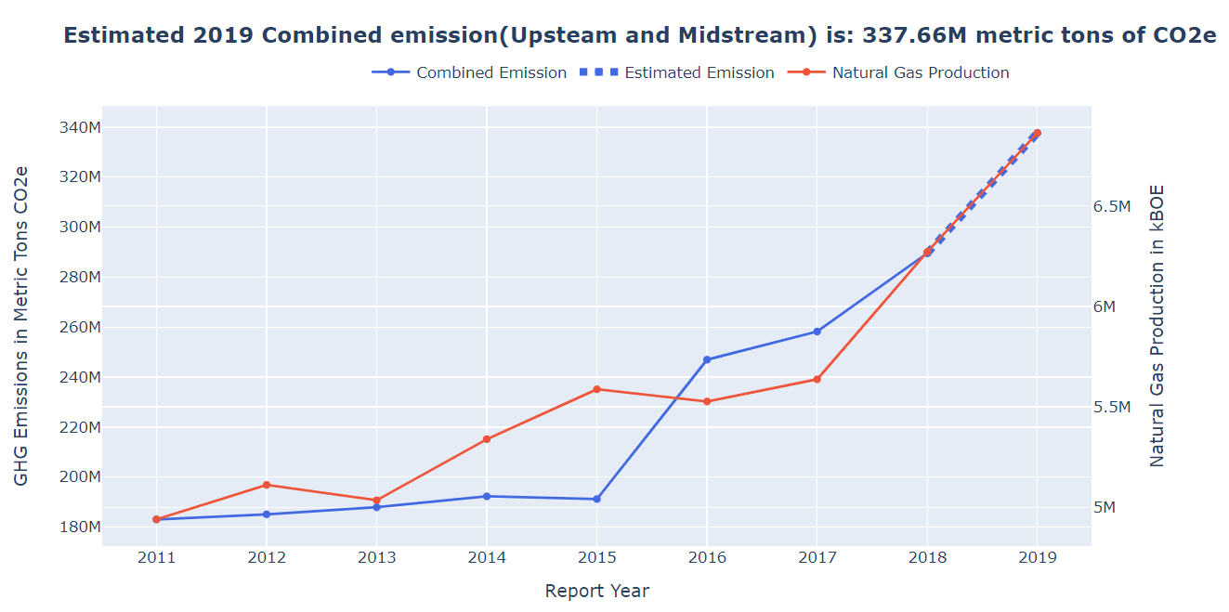
2019 Emission prediction
2019 Predicted GHG Emissions are : 337.65 million metric tons of CO2 equivalent

